Slide 1

程序的机器级表示
刘欣
QQ: 3340792577 微信：liuxinlehan
微信公众号：码农翻身(coderising)
码农翻身QQ群： 536010527

Slide 2
预备知识(1) : 堆栈

Slide 3
预备知识(2) ：寄存器

Slide 4
预备知识(3) ：汇编
指令 | 注释
MOVL $0x3051 ,%EAX | 把0x3051这个值放到 EAX寄存器， 4个字节
MOVL %EAX, -12(%EBP) | 把寄存器EAX的值，存放到EBP指向的地址减去12个字节的地方
PUSHL %EBP | 把寄存器EBP的值压栈
POPL %EBP | 把栈顶的值弹出， 存放到EBP寄存器中
SUBL %4 %ESP | 把ESP寄存器的值减去4

Slide 5
预备知识(4) ：指针

Slide 6
先来看高级语言：C语言
int demo(){
int x = 10;
int y = 20;
int sum = add(&x, &y);
printf(“the sum is %d\n”,sum);
return sum;
}
int add(int *xp, int *yp){
int x = *xp;
int y = *yp;
return x+y;
}

Slide 7
再看汇编
demo:
1 pushl %ebp
2 movl %esp %ebp
3 subl %24 esp
4 movl $10 -4(%ebp)
5 movl $20 -8(%ebp)
6 leal -8(%ebp) %eax
7 movl %eax 4(%esp)
8 leal -4(%ebp) %eax
9 movl %eax esp
call add
打印结果(略)
add:
1 pushl %ebp
2 movl %esp %ebp
3 pushl %ebx
4 movl 8(%ebp) %edx
5 movl 12(%ebp) %ecx
6 movl (%edx) %ebx
7 movl (%ecx) %eax
8 add %ebx %eax
9 popl %ebx
10 popl %ebp
11 ret

Slide 8
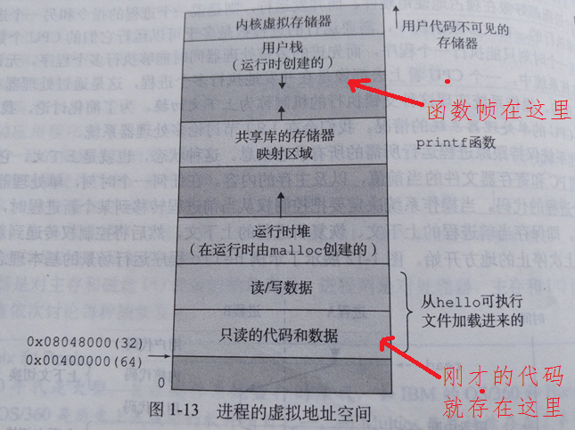
程序的存放： 从硬盘到内存

Slide 9
函数帧
void 函数A(){
....
函数B();
....
}
int 函数B(){
......
函数C();
......
}
int 函数C(){
......
函数D(); <- - 程序运行到了这一行
......
}

Slide 10
人肉CPU

Slide 11
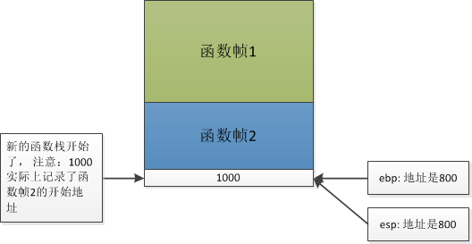
“人肉”CPU (1)
main:
1 pushl %ebp
2 movl %esp %ebp
3 subl %24 esp
4 movl $10 -4(%ebp)
5 movl $20 -8(%ebp)
6 leal -8(%ebp) %eax
7 movl %eax 4(%esp)
8 leal -4(%ebp) %eax
9 movl %eax esp
call add
打印结果(略)

Slide 12
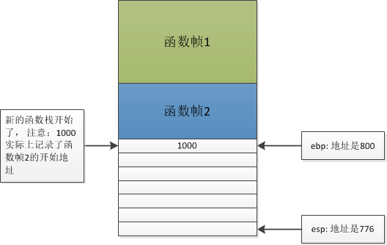
“人肉”CPU (2)
main:
1 pushl %ebp
2 movl %esp %ebp
3 subl %24 esp
4 movl $10 -4(%ebp)
5 movl $20 -8(%ebp)
6 leal -8(%ebp) %eax
7 movl %eax 4(%esp)
8 leal -4(%ebp) %eax
9 movl %eax esp
call add
打印结果(略)

Slide 13
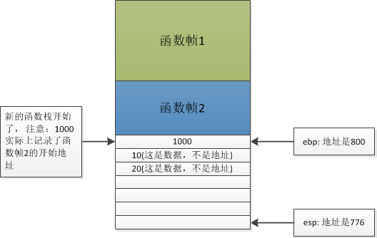
“人肉”CPU (3)
main:
1 pushl %ebp
2 movl %esp %ebp
3 subl %24 esp
4 movl $10 -4(%ebp)
5 movl $20 -8(%ebp)
6 leal -8(%ebp) %eax
7 movl %eax 4(%esp)
8 leal -4(%ebp) %eax
9 movl %eax esp
call add
打印结果(略)
设置局部变量！

Slide 14
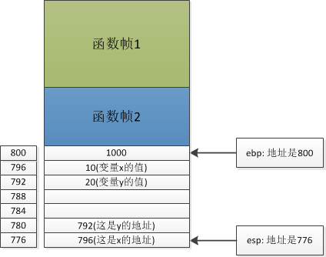
“人肉”CPU (4)
main:
1 pushl %ebp
2 movl %esp %ebp
3 subl %24 esp
4 movl $10 -4(%ebp)
5 movl $20 -8(%ebp)
6 leal -8(%ebp) %eax
7 movl %eax 4(%esp)
8 leal -4(%ebp) %eax
9 movl %eax esp
call add
打印结果(略)

Slide 15
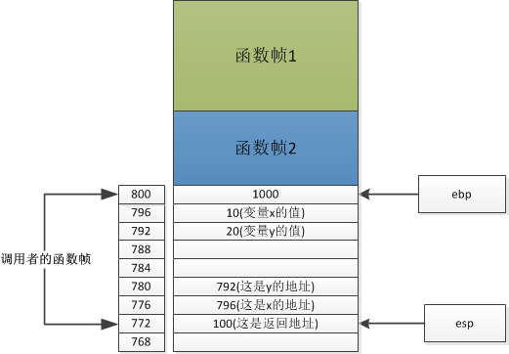
“人肉”CPU (5)
main:
1 pushl %ebp
2 movl %esp %ebp
3 subl %24 esp
4 movl $10 -4(%ebp)
5 movl $20 -8(%ebp)
6 leal -8(%ebp) %eax
7 movl %eax 4(%esp)
8 leal -4(%ebp) %eax
9 movl %eax esp
call add
打印结果(略)

Slide 16
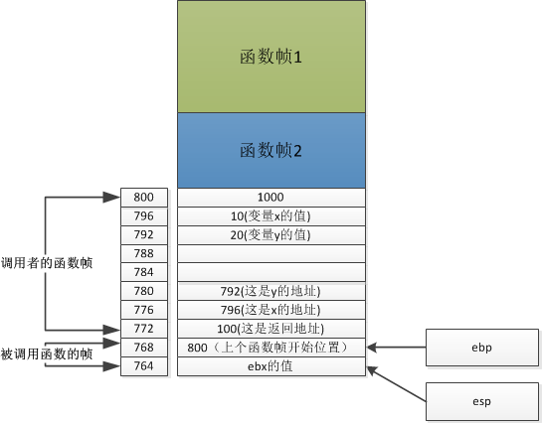
“人肉”CPU (6)
add:
1 pushl %ebp
2 movl %esp %ebp
3 pushl %ebx
4 movl 8(%ebp) %edx
5 movl 12(%ebp) %ecx
6 movl (%edx) %ebx
7 movl (%ecx) %eax
8 add %ebx %eax
9 popl %ebx
10 popl %ebp
11 ret

Slide 17
“人肉”CPU (7)
add:
1 pushl %ebp
2 movl %esp %ebp
3 pushl %ebx
4 movl 8(%ebp) %edx
5 movl 12(%ebp) %ecx
6 movl (%edx) %ebx
7 movl (%ecx) %eax
8 add %ebx %eax
9 popl %ebx
10 popl %ebp
11 ret

Slide 18
“人肉”CPU (８)
add:
1 pushl %ebp
2 movl %esp %ebp
3 pushl %ebx
4 movl 8(%ebp) %edx
5 movl 12(%ebp) %ecx
6 movl (%edx) %ebx
7 movl (%ecx) %eax
8 add %ebx %eax
9 popl %ebx
10 popl %ebp
11 ret

Slide 19
缓存区溢出攻击
void echo{
char buf[8];
gets(buf);
puts(buf);
}
char *gets(char *s){
int c;
char *dest =s;
int gotchar = 0;
while((c=getchar()) != '\n' && c != EOF){
*dest++ = c;
gotchar = 1;
}
*dest++ = '\0';
....
}

Slide 20
应用：Java虚拟机

Slide 21
Java 源程序和字节码
public class Test{
void add(int i, int j){
int sum = i+j;
}
void demo(){
add(10,20);
}
}
demo:
0: aload_0
1: bipush 10
3: bipush 20
5: invokevirtual #2
8: return
add:
0: iload_1
1: iload_2
2: iadd
3: istore_3
4: return

Slide 22
应用：Java虚拟机

Slide 23
应用：Java虚拟机

Slide 24

欢迎交流
QQ: 3340792577
QQ群: 536010527
微信公共号: 码农翻身(coderising)

